Slide 1
Mining Association Rules with FP Tree

Slide 2
Mining Frequent Itemsets without Candidate Generation
In many cases, the Apriori candidate generate-and-test method significantly reduces the size of candidate sets, leading to good performance gain.
However, it suffer from two nontrivial costs:
  It may generate a huge number of candidates (for example, if we have 10^4 1-itemset, it may generate more than 10^7 candidata 2-itemset)
  It may need to scan database many times

Slide 3
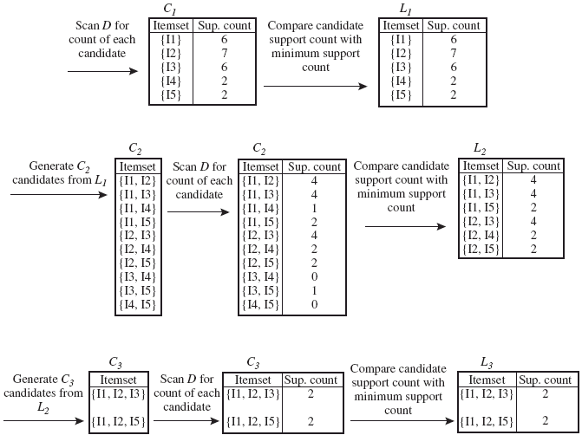
Association Rules with Apriori
Minimum support=2
Minimum confidence=70%

Slide 4
Bottleneck of Frequent-pattern Mining
Multiple database scans are costly
Mining long patterns needs many passes of scanning and generates lots of candidates
  To find frequent itemset i₁i₂…i₁₀₀
    # of scans: 100
Bottleneck: candidate-generation-and-test
Can we avoid candidate generation?

Slide 5
Process of FP growth
FP-Growth: allows frequent itemset discovery without candidate itemset generation. Two step approach:
  Step 1: Build a compact data structure called the FP-tree
    Built using 2 passes over the data-set.
  Step 2: Extracts frequent itemsets directly from the FP-tree

Slide 6
Step 1: FP-Tree Construction
FP-Tree is constructed using 2 passes over the data-set:
Pass 1:
  Scan data and find support for each item.
  Discard infrequent items.
  Sort frequent items in decreasing order based on their support.
Use this order when building the FP-Tree, so common prefixes can be shared.

Slide 7
Step 1: FP-Tree Construction
Pass 2:
Nodes correspond to items and have a counter
FP-Growth reads 1 transaction at a time and maps it to a path
Fixed order is used, so paths can overlap when transactions share items (when they have the same prfix ).
  In this case, counters are incremented
Pointers are maintained between nodes containing the same item, creating singly linked lists (dotted lines)
  The more paths that overlap, the higher the compression. FP-tree may fit in memory.
Frequent itemsets extracted from the FP-Tree.

Slide 8
Association Rules
Let’s have an example
  T100 1,2,5
  T200 2,4
  T300 2,3
  T400 1,2,4
  T500 1,3
  T600 2,3
  T700 1,3
  T800 1,2,3,5
  T900 1,2,3

Slide 9
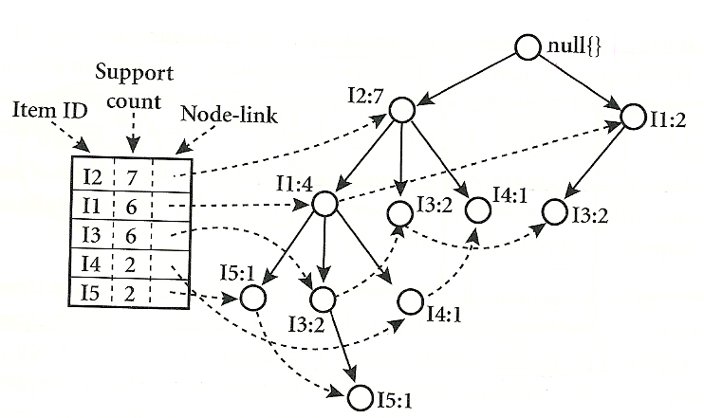
FP Tree

Slide 10
FP-Tree size
The FP-Tree usually has a smaller size than the uncompressed data - typically many transactions share items (and hence prefixes).
  Best case scenario: all transactions contain the same set of items.
    1 path in the FP-tree
  Worst case scenario: every transaction has a unique set of items (no items in common)
    Size of the FP-tree is at least as large as the original data.
    Storage requirements for the FP-tree are higher - need to store the pointers between the nodes and the counters.
The size of the FP-tree depends on how the items are ordered
Ordering by decreasing support is typically used but it does not always lead to the smallest tree (it's a heuristic).

Slide 11
Step 2: Frequent Itemset Generation
FP-Growth extracts frequent itemsets from the FP-tree.
Bottom-up algorithm - from the leaves towards the root.
Divide and conquer: first look for frequent itemsets ending in e, then de, etc. . . then d, then cd, etc. . .
First, extract prefix path sub-trees ending in an item(set).

Slide 12
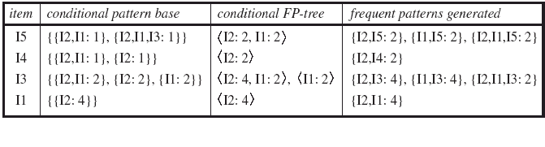
Mining the FP tree

Slide 13
FP Tree

Slide 14
Benefits of the FP-tree Structure
Completeness
  Preserve complete information for frequent pattern mining
  Never break a long pattern of any transaction
Compactness
  Reduce irrelevant info—infrequent items are gone
  Items in frequency descending order: the more frequently occurring, the more likely to be shared
  Never be larger than the original database (not count node-links and the count field)
  For Connect-4 DB, compression ratio could be over 100

Slide 15
Exercise
TID | Items_bought
T1 T2 T3 T4 T5 | M, O, N, K, E, Y D, O, N, K , E, Y M, A, K, E M, U, C, K ,Y C, O, O, K, I ,E
A dataset has five transactions, let min-support=3 and min_confidence=80%
Find all frequent itemsets using FP Tree

Slide 16
Association Rules with Apriori
K:5 KE:4 KE
E:4 KM:3 KM
M:3 KO:3 KO
O:3 => KY:3 => KY => KEO
Y:3 EM:2 EO
EO:3
EY:2
MO:1
MY:2
OY:2

Slide 17
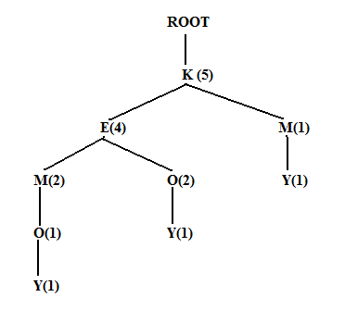
Association Rules with FP Tree
K:5
E:4
M:3
O:3
Y:3

Slide 18
Association Rules with FP Tree
Y: KEMO:1 KEO:1 KY:1
K:3 KY
O: KEM:1 KE:2
KE:3 KO EO KEO
M: KE:2 K:1
K:3 KM
E: K:4 KE

Slide 19
Why Is FP-Growth the Winner?
Divide-and-conquer:
  decompose both the mining task and DB according to the frequent patterns obtained so far
  leads to focused search of smaller databases
Other factors
  no candidate generation, no candidate test
  compressed database: FP-tree structure
  no repeated scan of entire database
  basic ops—counting local freq items and building sub FP-tree, no pattern search and matching

